Slide 1
CONNECTICUT UNITED WAYS
EMBARGOED UNTIL 9/18/23: DO NOT DISTRIBUTE
Connecticut United Ways
2023 ALICE Report
alice.ctunitedway.org

Slide 2
ALICE:
Asset Limited, Income Constrained, Employed
ALICE
Notes:
ALICE households in CT:
Are working hard at the jobs available to them, but not earning enough to get ahead, if not falling behind
Are often essential workers
Typically have little to no savings, putting them at constant risk for increased financial instability
Are disproportionately people of color
Note: All data in this presentation, unless otherwise, noted, is from the 2023 ALICE Report or ALICE Essentials Index.

Slide 3
Connecticut Key Findings:
Financial hardship of CT households continues to grow.
The problem: a mismatch between wages and the costs of basics.
Racial and gender disparities persist.
Pandemic-related enhancements to federal benefits have expired – increasing the strain.
The rising costs of household essentials is putting financial stability further out of reach.
alice.ctunitedway.org
Notes:
The first four findings are from the 2023 ALICE report, and the final finding is informed by a tool we are deploying this year with our partner, United For ALICE, the ALICE Essentials Index.

Slide 4
KEY FINDING
1
Financial hardship continues to grow in Connecticut.

Slide 5
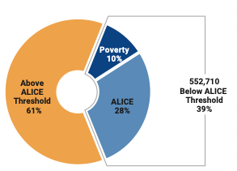
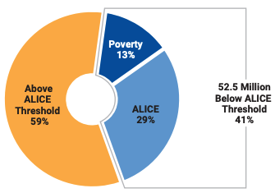
Of the 1.4 million households in Connecticut, 552,710 — or 39% — had income below the ALICE Threshold of Financial Survival in 2021; more than 54,000 additional households compared to 2019.
National
Connecticut
Notes:
ALICE is a data-driven report to identify hardship in Connecticut, and inform action in the 20+ states that are part of the ALICE movement.
Nearly 40% of households in CT are ALICE In Connecticut. That's lower than the national average, and one percentage point higher than in 2018. While only one percentage point, represents 54,432 number of households.
Over the last 15 years, ALICE has grown nationally and in CT: ALICE jumped from 28% of the state's households in 2007 to 39% in 2021. There was no recovery from the Great Recession for ALICE households.
*Please note that the % of households in Connecticut that are ALICE is 38.7%, which is rounded to 39%
Note: The total number of households in Connecticut increased by 4% 2019-2021

Slide 6
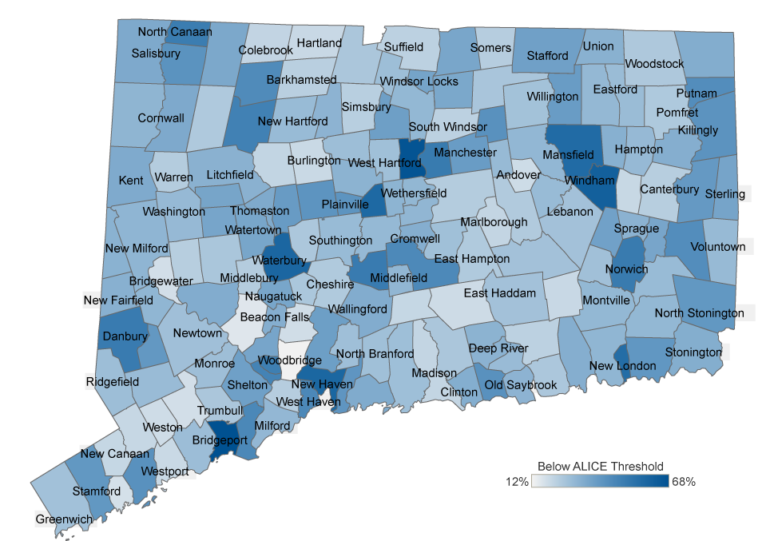
ALICE households live in every community in Connecticut.
39% of Connecticut Households live below the ALICE Threshold.
In some communities, that percentage is as high as 68%.
Notes:
[LOCALIZE TO INCLUDE THE % OF HOUSEHOLDS LIVING BELOW THE ALICE THRESHOLD IN YOUR CATCHMENT AREA]
If this map only reflected towns that had 12% or more poverty, it would send a very different message about financial hardship in CT.
We get to these numbers by looking at costs of household essentials in each Connecticut County to create a Household Survival Budget (HSB) that also adjusts for family composition and geography.

Slide 7
 | 2018 % Below ALICE Threshold | 2021 % Below ALICE Threshold | % Change
Central and Northeastern | 35 | 39 | +4
Coastal and Western | - | 40 | -
Greater New Haven | 44 | 42 | -2
Greater Waterbury | 44 | 43 | -1
Greenwich | 29 | 26 | -3
Meriden and Wallingford | 42 | 43 | +1
Middlesex | 29 | 33 | +4
Milford | 31 | 30 | -1
Naugatuck and Beacon Falls | 38 | 35 | -3
Northwest | 33 | 38 | +5
Southeastern | 33 | 37 | +4
Southington | 29 | 29 | -
Valley | 40 | 37 | -3
West Central | 34 | 39 | +5
The Household Survival Budget adjusts for geography and household composition.
View more household compositions and maps by county, town, and legislative district at Unitedforalice.org/Connecticut
Notes:
[REMOVE CHART AND LOCALIZE USING THE MAP AND TABLES FROM YOUR CATCHMENT PAGE]

Slide 8
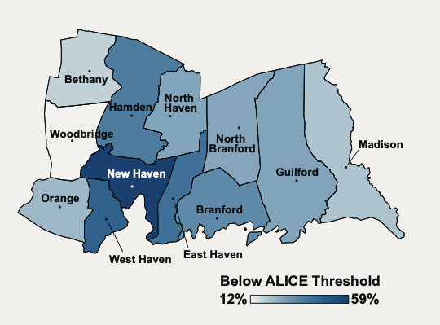
United Way of Greater New Haven, ALICE Households 2021
NEED TO SEE IF WE CAN HAVE MAP IMAGES ON CLEAR BACKGROUND
View more household compositions and maps by county, town, and legislative district at Unitedforalice.org/Connecticut
Notes:
[REMOVE CHART AND LOCALIZE USING THE MAP AND/OR TABLES FROM YOUR CATCHMENT PAGE: MAP IMAGES ARE AVAILABLE IN THE SHARED TEAMS DRIVE IN THE TOOKIT SECTION]
The Household Survival Budget adjusts for geography and household composition.

Slide 9
ALICE Methodology
Overview

Slide 10
ALICE Household Survival Budget Methodology Overview | ALICE Household Survival Budget Methodology Overview
 | Description | Source
Housing | Fair Market Rent (40th percentile) for an efficiency, one-bedroom, or two-bedroom apartment (based on family size), adjusted in metro areas using the ACS – minus utilities. | ACS metro housing costs and US Department of Housing and Urban Development
Utilities | As captured by the Community Expenditure Survey. | CEX
Child Care | Cost for registered Family Child Care Homes for infants (0-2 years), preschool-age (3-4), and school-age children (5-12). | Connecticut Office of Early Childhood, 2022
Food | USDA Thrifty Food Plan by age with county variation from Feeding America; reflects updates to USDA Thrifty Plan in 2021. | Feeding America; US Department of Agriculture (USDA)
Transportation | Operating costs for a car (average daily miles by age, cost per mile, license, fees, and insurance), or public transportation where viable. | AAA, Federal Highway Administration, The Zebra (car); CEX (public transportation)
Health Care | Health insurance premiums based on employer-sponsored plans plus out-of-pocket costs for households with $40,000-$69,000 annual income by age, weighted with poor-health multiplier. | Centers for Medicare and Medicaid Services (CMS); CEX (health); Medical Expenditure Panel Survey
Technology | Smartphone plan with 10GB of data for each adult in a household; increased from 5GB to 10GB data to reflect increased need for internet access. | Consumer Reports
Miscellaneous | Cost overruns estimated at 10% of the budget, excluding taxes, to cover one-time unanticipated costs within the other categories.
Taxes | Federal, state, and local taxes owed on the amount of income to cover the Survival Budget, as well as tax credits, including the federal Child Tax Credit (CTC) and the federal Child and Dependent Care Tax Credit (CDCTC); due to the significant effect of the expanded tax credits in 2021, total taxes before federal credits and the credits are both listed. | Internal Revenue Services; Tax Foundation
The full 2023 ALICE Report methodology is available at unitedforalice.org/methodology.
Notes:
A few changes to note this year:
Utilities are broken-out from Rent
The USDA made changes to the Thrifty Food Plan that includes healthier options than those included in the past definition.
For families with dependents, the Taxes category includes tax credits for the temporarily, expanded federal Child Tax Credit and Child and Dependent Care Tax Credits, as well as federal, state and local taxes owed.

Slide 11
KEY FINDING
2
The problem: mismatch between wages and the cost of basics.

Slide 12
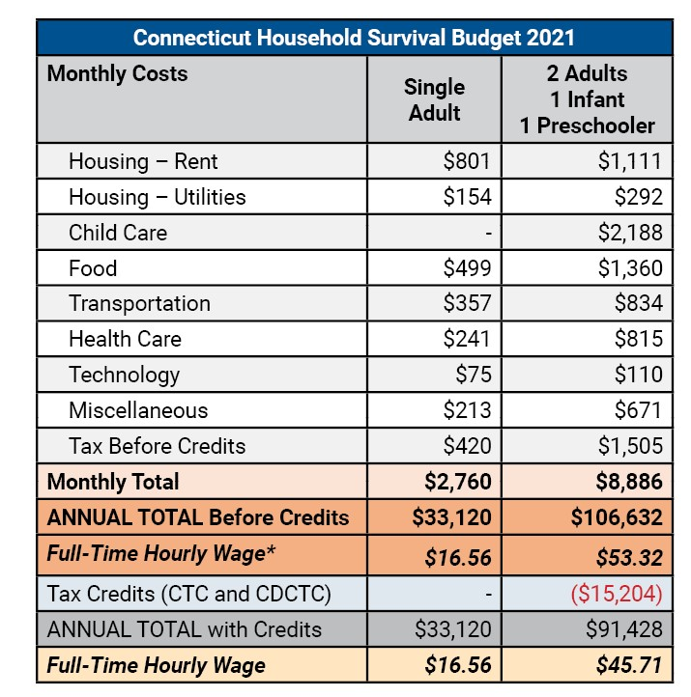
The ALICE Household Survival Budget provides the bare minimum budget for essentials by household composition, in every county.
*Full-Time Hourly Wage is based on working 40 hours per week, 50 weeks per year.
Notes:
[LOCALIZE BY ADDING YOUR REGIONAL HOUSEHOLD SURVIVAL BUDGET TABLE HERE]
Household Survival Budget (HSB) for a Single Adult and a family of four with two working parents, one infant, and one preschooler. In Connecticut, a family with two young children requires significant income to provide child care – notice it is the largest line item in the HSB.
The 2021 HSB for a family of with two children – shows the difference in the budget with pandemic-related enhanced federal benefits, like the temporarily increased federal Child Tax Credit and Child and Dependent Care Credits included, and with those credits removed. But those important benefit enhancements have expired. Expired, had low uptake by ALICE households or exclusions that created barriers for ALICE households. The $106,000-figure is a more accurate representation of actual costs, and helps us track ALICE wages and income over time.
This is a conservative budget. Many families incur higher costs, especially for housing, as units may not be available at HUD Fair Market Rent.
Traditional public assistance does not reach all people in households that are struggling financially. Due to income and assets limits, most ALICE households are not able to participate in public assistance. For example, only 12% of people living below the ALICE threshold in CT received TANF or General Assistance support in 2021.
Note: the 2021 Federal Poverty Level was single = $12,880; Family = $26, 500

Slide 13
To more accurately represent true household costs for a family with dependents, Connecticut United Ways rely on the Household Survival Budget that excludes the now-expired enhancements to key federal tax credits – the Child Tax Credit (CTC) and Child and Dependent Care Tax Credit (CDCTC).
Notes:
United For ALICE estimates that 45% of Connecticut households living below the ALICE Threshold with children did not receive the enhanced federal Child Tax Credit.
The Urban Institute and Brookings Institution Tax Policy Center notes that that while the CDCTC was temporarily expanded and made refundable for 2021, it benefits only a small share of parents

Slide 14
The Household Survival Budget includes only the necessities to live and work in the modern economy.
Only 41% of
Connecticut's
struggling households had emergency savings in 2021
Most notably, it does not include savings or debt service.
Notes:
In November 2021, 41% of households below the ALICE threshold had enough emergency savings, or "rainy day funds," to cover 3-months of expenses, according to the Federal Reserve SHED survey. In October 2019 it was 54%
Relatively small, unexpected expenses, such as a car repair or a modest medical bill, can be a hardship for many families. When faced with a hypothetical expense of $400, 63 percent of all adults in 2022 said they would have covered it exclusively using cash or equivalents. The remainder said they would have paid by borrowing or selling something, or said they would not have been able to cover the expense.
In 2022, parents saw a drop of 7 percentage points in this measure to 57 percent. The Fed speculates it has to do with the expiration of the enhanced federal Child Tax Credit.

Slide 15
8 of the 20 Most Common Occupations, Connecticut, 2021
Occupation | Total Employment (BLS) | Median Hourly Wage (BLS) | Percent Median Wage Change From 2019 (BLS) | Percent Workers Below ALICE Threshold (ACS PUMS)
Retail Salesperson | 41,520 | $14.16 | 6% | 32%
Personal Care Aides | 38,040 | $14.30 | 12% | 58%
Cashiers | 37,600 | $13.80 | 17% | 43%
Stockers and Order Fillers | 30,160 | $17.34 | 29% | 43%
Driver/Sales Workers and Truck Drivers | 29,060 | $20.53 | 2% | 28%
Secretaries and Administrative Assistants | 24,960 | $22.73 | -1% | 24%
Cooks | 18,930 | $16.56 | 11% | 46%
Secondary School Teachers | 16,890 | $37.72 | -1% | 9%
60% of the top 20 jobs in
Connecticut still paid less than $20/hour ($40,000/year) in 2021.
Data for the 20 top occupations in Connecticut, 2021, are available in the 2023 ALICE Report.
BLS = US Bureau of Labor Statistics; ACS = American Census Survey Public, PUMS = Public Use Microdata Sample, US Census Bureau
Notes:
The HSB tells us about actual costs for CT households in different parts of the state. The other part of the equation is income.
The table is an excerpt from a dataset that looks at the 20 most common occupations in Connecticut in 2021, most saw an increase in the median wage.
But given that wages had stagnated for a decade, many of the most common jobs still had a substantial percentage of workers who lived below the ALICE Threshold in 2021.
For a family of four with two small children – the two adults would need two full time jobs at $27 per hour each to make ends meet. ($53/hour)

Slide 16
KEY FINDING
3
Rates of financial hardship in Connecticut differed substantially by race and gender.

Slide 17
Disparities are a result of multiple factors including persistent racism, gender discrimination and geographic barriers.
In Connecticut:
54% of Black households
57% of Hispanic households
68% of female-headed households with children
lived below the ALICE Threshold.
Notes:
These forces – persistent racism, gender discrimination and geographic barriers – limit many families' access to resource and opportunities for financial stability.
We continue to see significant disparities by race and gender in the ALICE data: Black and Brown families, and female-headed households with children, disproportionately live below the ALICE Threshold.
In 2021, the largest number of households below the ALICE threshold were White (making up 33% of all White households). And while the number of struggling households was lower for smaller population groups, the percentage of those households living below the ALICE Threshold was disproportionately higher (except Asian households). For example, 54% of Black households, 57% of Hispanic households, and 68% of female-headed households with children were below the ALICE Threshold.

Slide 18
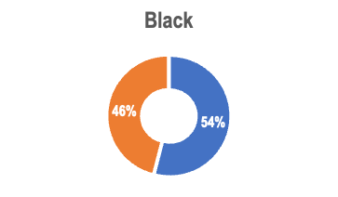
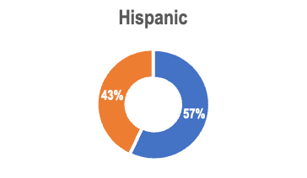
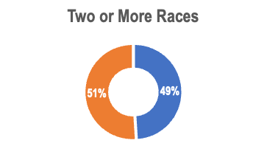
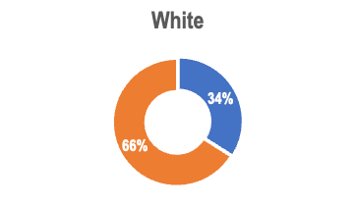
In many cases, the pandemic exposed and exacerbated disparities and vulnerabilities that have long existed in our society, with substantial differences in rates of hardship by race/ ethnicity, age, and household composition.
In Connecticut in 2021, Black and Hispanic households, young households, and single-parent households had the highest rates below the ALICE Threshold. White and Asian households, working-age households, and married-parent households had the lowest rates below the Threshold.

Slide 19
KEY FINDING
4
Pandemic-related enhancements to federal benefits have expired – increasing the strain.

Slide 20
In 2021, the enhanced federal Child Tax Credit + Child and Dependent Care Tax Credit contributed $15,204 to the household budget of two working adults with one infant and one toddler.
Pandemic Assistance in 2021
January to November 2021 — Emergency rental assistance provided on average $4,345 to LI households to pay rent/utilities
March 2021 — Economic Impact Payments of up to $1,400 for eligible individuals.
July to December 2021 — enhanced Child Tax Credit + direct monthly payments (up to $300/month/child).
September 2021 — National end of all Emergency Pandemic UI benefits.
October 2021 — End of CDC’s eviction moratorium.
Notes:
The enhanced federal tax credits, sunset at the end of 2021. During their time, we saw the greatest reduction in the rates of childhood poverty and the greatest reduction in the poverty rates between White children and families and Black and Brown children. There are few ways for households to replace more than $15,000 in income. And, prices continue to rise.
Note: The maximum federal Child Tax Credit amount increased to $3,000 per qualifying child between ages 6 and 17 ($250/month) and $3,600 per qualifying child under age 6 ($300/month).

Slide 21
KEY FINDING
5
The rising costs of household essentials is putting financial stability further out of reach.

Slide 22
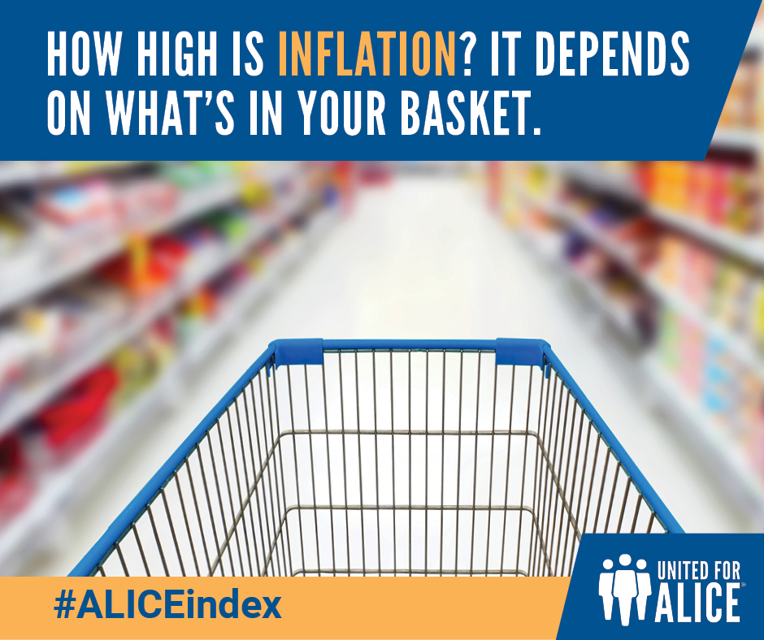
With the cost of basics climbing higher and ALICE wages failing to keep up, workers have lost buying power.
Notes:
With the cost of basics climbing higher, and ALICE wages failing to keep up, little by little it added up from 2007 to 2022. As a result, workers have lost buying power. For a retail salesperson in Connecticut, the sustained lag behind the actual cost of basic goods equates to nearly $42,500 over the last 15 years — more than a full year's earnings.

Slide 23
The ALICE Essentials Index, which measures change over time in the cost of household essentials, projects an 18.2% statewide increase in the Household Survival Budget from 2021 to 2023 (before taxes).
For the average Connecticut household, depending on the available tax credits, the costs of basics in 2023 could be as high as $126,000 for a family of four and $39,000 for a single adult.
Learn more at unitedforalice.org/essentials-index.
Notes:
[LOCALIZE USING THE DATA ON YOUR CATCHMENT PAGE TO UPDATE THE PROJECTED COST OF THE HSB IN 2023]
The ALICE Essentials Index includes only essential household items (housing, child care, food, transportation, health care and smartphone plan). In comparison, the Bureau of Labor Statistics' Consumer Price Index (CPI) covers a larger bundle of good and services – over 200 categories.

Slide 24
Connecticut ALICE Household Survival Budget Over Time
Notes:
[UPDATE THIS CHART WITH YOUR LOCAL DATA FROM PREVIOUS ALICE REPORTS – AVAILABLE AT ALICE.CTUNITEDWAY.ORG]
Across the U.S., the ALICE Essentials Index has increased at a higher rate than the CPI for more than fifteen years. From 2007 to 2023, the average annual rate of increase for the ALICE Essentials Index was 3.3%, while the CPI increased by 2.5% on average.
The historic levels of inflation in the last few years, which has increased at a higher rate on household essentials, puts financial stability further out of reach for CT households.
RENT EXAMPLE: According to the federal Department of Urban Development data, Connecticut has the 7th highest rent in the country out of 56 states and territories. The 2024 HUD Fair Market Rent including utilities for a two bedroom in Bridgeport is $1,967/month; for the Stamford-Norwalk area it is $2,628. (ALICE 2021 rent+ utilities 2bdr = $1,403.) HUD Fair Market Rents are well known to represent the low end of the actual rental market.

Slide 25
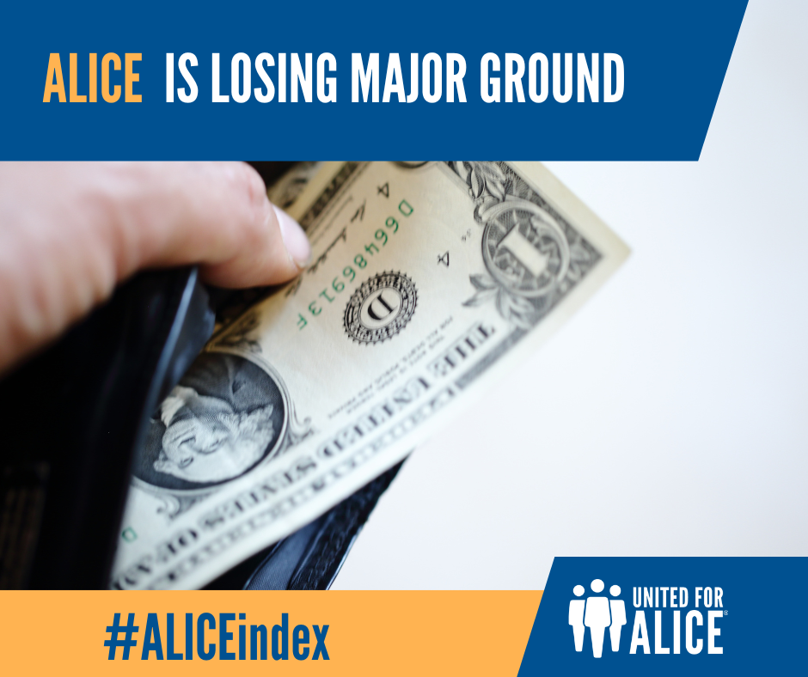
With the cost of basics climbing higher and ALICE wages failing to keep up, ALICE households continue to lose buying power.
For a retail salesperson in Connecticut, that loss over 15 years equates to nearly $42,500 – more than a full year's earnings.
Notes:
With the cost of basics climbing higher, and ALICE wages failing to keep up, little by little it added up from 2007 to 2022. As a result, workers have lost buying power. For a retail salesperson in Connecticut, the sustained lag behind the actual cost of basic goods equates to nearly $42,500 over the last 15 years — more than a full year's earnings.

Slide 27
Thank you!
For more information, contact:
Amy Casavina Hall, United Way of Connecticut
amy.casavinahall@ctunitedway.org
amy.casavinahall@ctunitedway.org
alice.ctunitedway.org
Notes:
[LOCALIZE WITH YOUR CONTACT INFORMATION]

